Slide 1

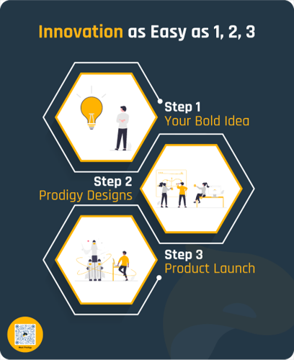

Project Team:
Cory Gish & Ryan Logsdon
Project Advisor:
David Mackenzie

Slide 2
Project Goals:
Project Background:
Research and understand what information users need to enhance the maintenance, care, and performance of their vehicles.
Develop a connected and interactive solution to display data visualizations of vehicle diagnostic data.
Provide users an ability to analyze data and make informed decisions about how to improve the performance of a single vehicle or entire fleet.
This project is a data collection and analysis tool for consumer and commercial automotive vehicles. Users for this device include mechanics, fleet managers, data analysts, and conventional drivers. The system will allow users to view, analyze, and improve vehicle performance through a multi-platform analysis tool including in-vehicle display, web application, and a virtual reality environment.

Slide 3
Intellectual Merits:
Blues Wireless IoT Modules:
The Metaverse Maintenance project was developed using Blues Wireless IoT modules to provide the system with both cellular and Wifi IoT connectivity. Through their generosity, we were able to showcase a prototype of the system at CES 2023, the world's largest consumer electronics show, based in Las Vegas, Nevada.
Vehicle Node Point Data Visualizations:
Using Noda.io, a VR mind mapping tool, we developed custom node point maps to provide users with a state-of-the-art data visualization for analysis of various diagnostic sensor data.
Bluetooth OBD II Interface:
The data collection begins from the Bluetooth OBD II interface that communicates with the car and provides information to the Raspberry Pi, like speed and RPM.

Slide 4
Broader Impacts:
Professional Virtual Reality Applications
Although there are a few exceptions, virtual reality is primarily occupied with advancing gaming technology and experiences throughout the industry. We believe that Metaverse Maintenance provides a foundation for how this technology can have meaningful impacts across multiple industries including training, collaboration, research and design, product visualizations, market research, and consumer engagement.
Environmental Impact
Metaverse Maintenance provides a variety of analytical information such as evaporative purge, which controls the emission of fuel vapor from the fuel tank in a vehicle's evaporative emission control system (EVAP). Allowing users to better understand a vehicle's performance will promote efficient and clean operation.

Slide 5
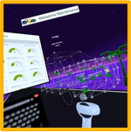
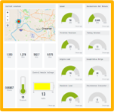

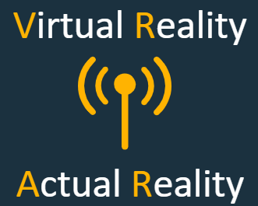
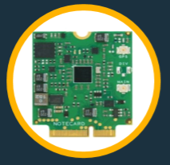


Design Specifications pt. 1:
System Overview:
The Metaverse Maintenance system collects data from a vehicle through its OBD II port. This data is displayed in real-time on the in-vehicle display.
Data is passed via the Blues IoT module to Losant, a cloud IoT management platform.
From here, data is passed to a web-application to be viewed across multiple platforms.
A VR interface is provided to users through Noda.io.
The web application and VR interface provide users with various data visualization and analysis tools to enhance the performance of their vehicle or fleet.
Digital Twin

Slide 6
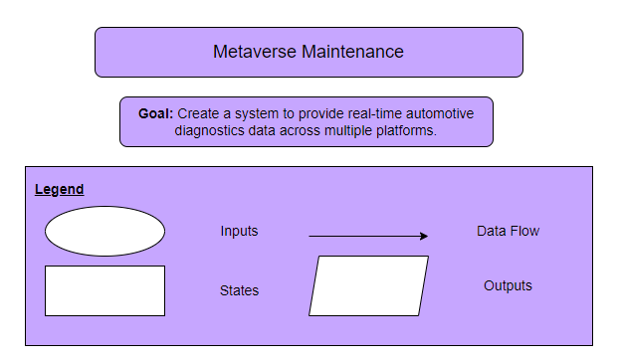
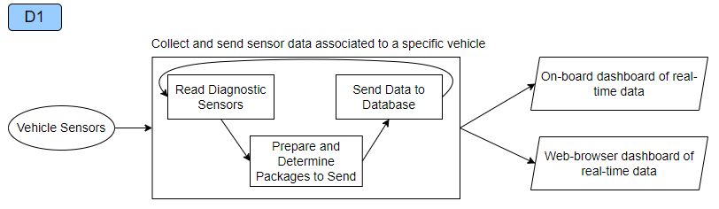
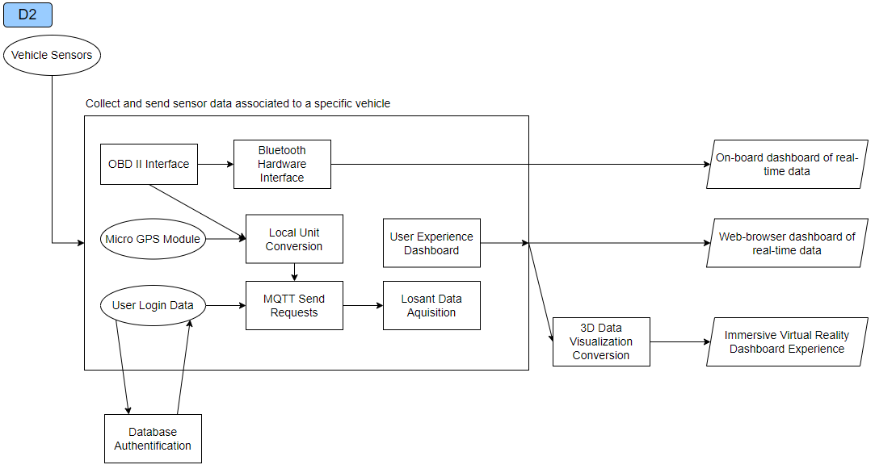
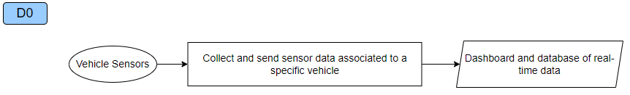
Design Specifications pt. 2:
Design Diagrams:

Slide 7
Technologies:
Raspberry Pi – The majority of computing done in this system is handled by a Raspberry Pi 3 Model B. This device allows communication from the OBD interface to the in-car display, and with the Blues IoT module.
OBD II Interface – The OBD II interface interacts with the car through the STN1110 chip, which is an OBD to UART interpreter. The on-board microcontroller, the SAMD21, sends requests to this IC and receives the desired car data. This information is then send through Bluetooth to the Raspberry Pi.
Blues Wireless IoT Module – The Blues IoT module is integrated into the system to provide cellular and wifi connectivity to the raspberry pi. I2C communication protocols, these modules provide plug-and-play connectivity to any system.
Noda.io – Although designed as a mind-mapping tool, Noda’s integrated API allowed for real-time data visualizations to be communicated from a vehicle, through Losant, and into VR with minimal latency.
Losant – Losant is a cloud-based IoT platform that creates the foundation of the Metaverse Maintenance system. Losant allows users to store and track real-time data of devices with hundreds of attributes. Moreover, this platform provides dashboards that can be easily integrated into web-applications.

Slide 8
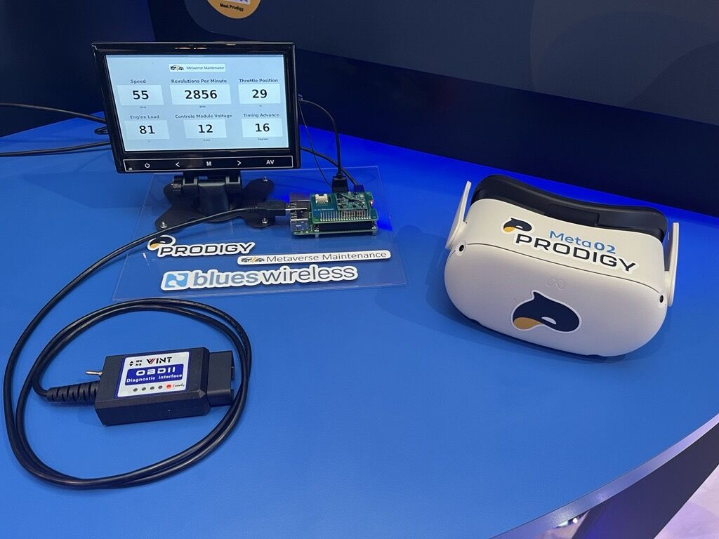
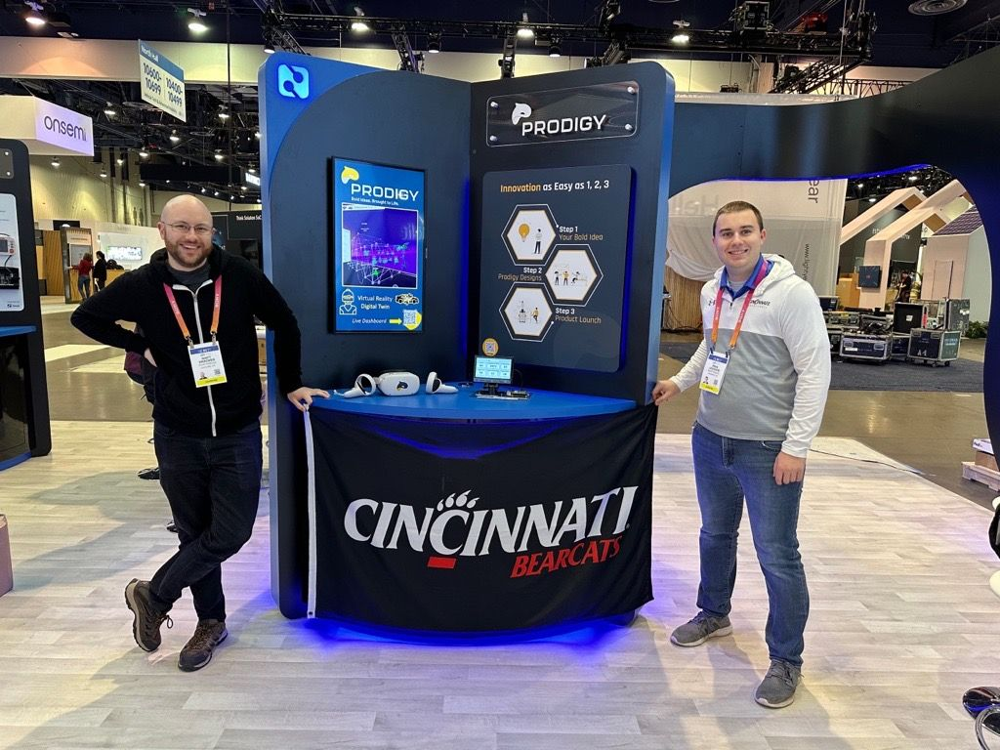
Milestones:
Complete Requirements Elicitation – 10 / 09 / 2022
First Hardware Prototype – 10 / 23 / 2022
First Software Prototype – 10 / 13 / 2022
Fully Functional Software Prototype – 1 / 5 / 2023
CES Trade Show – 1 / 5 / 2023
Complete Software Testing and Debugging – 2 / 26 / 2023
Complete Hardware Testing – 3 / 5 / 2023
Finish Project – 4 / 9 / 2023

Slide 9
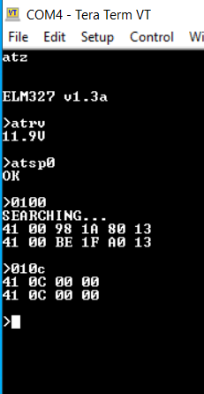
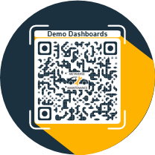
Results: Overview
Communication with the car begins with a series of commands for the STN1110 IC. These commands reset the device, get car battery voltage, then automatically determines the correct OBD II communication protocol.
Data is requested through a variety of PID values, and returned in hex format. Converting this information to decimal allows for processing of the requested car data.
Through the use of Losant, multi-platform web-based applications can live stream data using a variety of data visualization tools. Use the QR code to view some of these live dashboards →
Live Dashboard

Slide 10
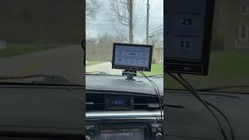
Results: In-Vehicle Display

Slide 11
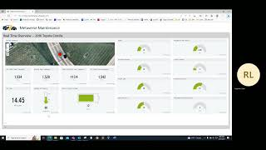
Results: Web Application

Slide 12
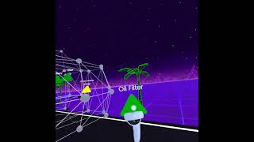
Results: Virtual Reality

Slide 13
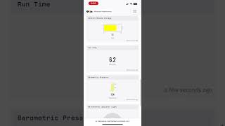
Results: Mobile Device

Slide 14
Challenges:
It was desired to be able to offer OBD II communication through a variety of different types of protocols, but proved to be a challenge. Finding the STN1110 IC was great as it allowed for automatic OBD II protocol detection.
Getting the microcontroller operational for our intended purposes led to several issues, like wrong baud rates and incorrect pin multiplexing, but testing and referencing the datasheet aided in this challenge.
Communication between the Bluetooth module in the OBD II interface and the Raspberry Pi is currently being worked on as the processing of data from the car to the microcontroller, then to the Raspberry Pi needs improvement and optimization.

